Slide 1
Multinomial Naive Bayes for Text Categorization Revisited
Authors: Ashraf M. Kibriya, Eibe Frank, Bernhard Pfahringer, and Geoffrey Holmes
Presenters:
- Shehzad ul Islam – 1001555356
- Harshal Parmar - 1001502041

Slide 2
Outline
Introduction
Experimental Setup
Multinomial Naïve Bayes
Evaluating Standard Multinomial Naïve Bayes
Improving Multinomial Naïve Bayes
Conclusions

Slide 3
Introduction
Presenting empirical results for several versions of the multinomial Naïve Bayes classifier.
Comparing Standard Multinomial Naïve Bayes with Transformed Weight-Normalized Complement Naïve Bayes classifier (TWCNB).
Need for TWCNB.
TWCNB is easy to implement, has good running time and claims to be as accurate as SVMs.

Slide 4
Experimental Setup
Datasets
Feature Generation
Multinomial Naïve Bayes
Transformed Weight-Normalized Complement Naïve Bayes

Slide 5
Datasets
20 Newsgroups
Industry Sector Dataset
WebKB Dataset
Reuters-21578 Dataset (Multiple class per document)

Slide 6
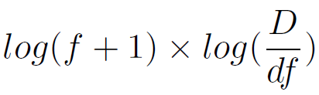
Feature Generation
Bag of words approach
Documents represented as a set of words
Reuters dataset treated different than others.
TFIDF(word) =

Slide 7
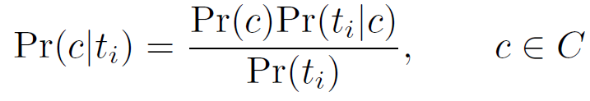
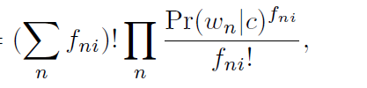
Multinomial Naïve Bayes
It is used to compute class probabilities by using Bayes Rule:
Prior: Pr(c) = # of document of class C / Total # of documents
Pr(ti|c) =

Slide 8

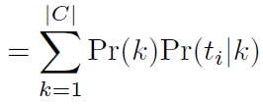

Multinomial Naïve Bayes (cont.)
Pr(wn|c)
Pr(ti)
Pr(ti|c)

Slide 9
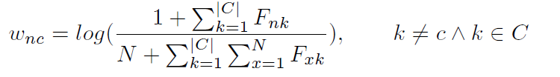


Transformed Weight-Normalized Complement Naive Bayes
TWCNB estimates the parameters of class c by using data from all classes apart from c and uses word weight rather than probability.
class(ti)
class(ti)

Slide 10


TWCNB (cont.)
class(ti)
For multi-label datasets, we require a score representation of how likely a document belongs to class.
Score is calculated using all vs rest approach:

Slide 11
Evaluating Standard Multinomial Naïve Bayes
Comparing MNB with TWCNB, TCNB and linear SVMs
In case of SVM, Sequential minimal optimization (SMO) algorithm is used.
Results with full and reduced vocabulary are presented.
Reuters dataset results reported as precision-recall break-even points.

Slide 12
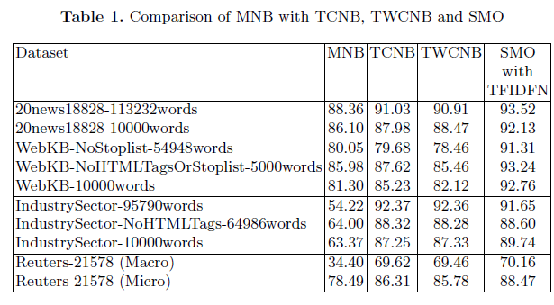

Slide 13
Improving Multinomial Naïve Bayes
Evaluating ways to increase the accuracy of MNB.
Comparing the results when using MNB alone, with TFIDF (not normalized), normalized with respect to average vector length (TFIDFNa) and normalized to unit vector (TFIDFN).

Slide 14
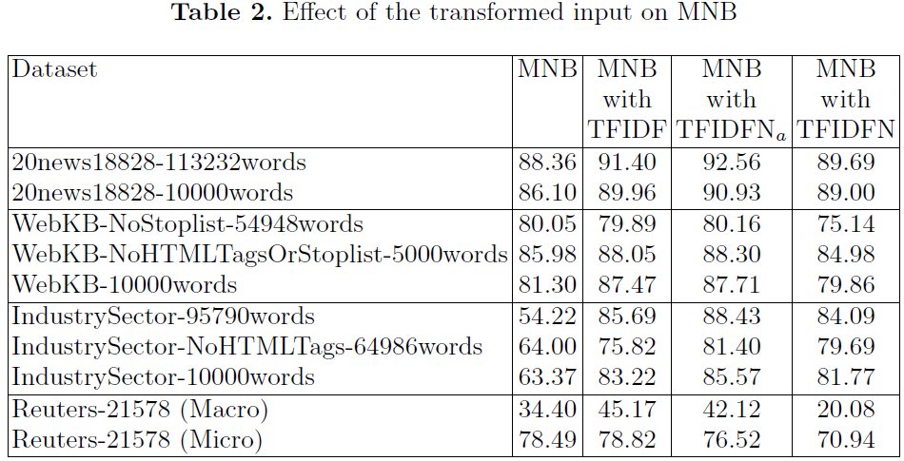

Slide 15
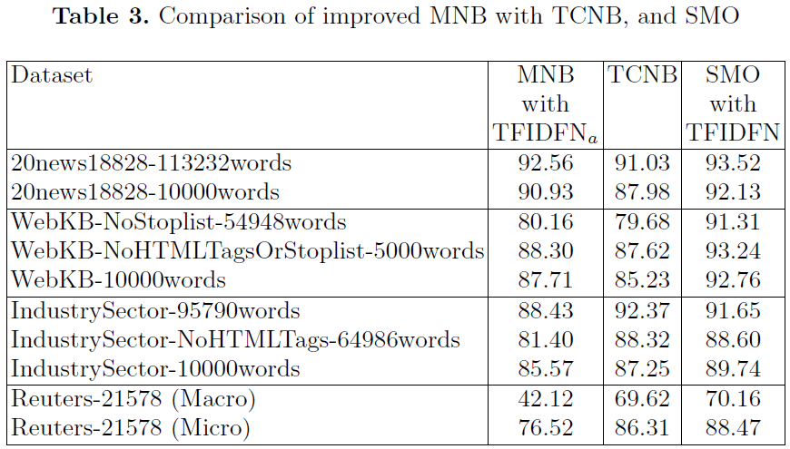

Slide 16

Locally Weighted Learning
Use only a subset of the training documents.
Documents are selected based on their Euclidean distance to the test document.
Select k (neighborhood size) nearest documents.
Divide the distance by the kth nearest neighbor.
f(di)

Slide 17
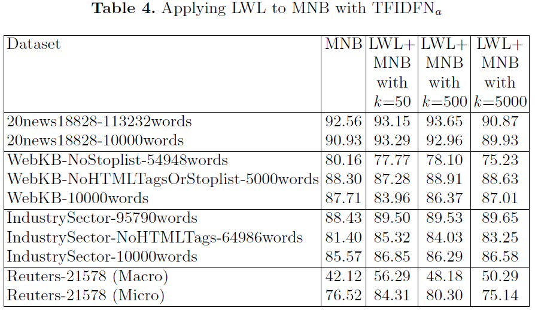

Slide 18
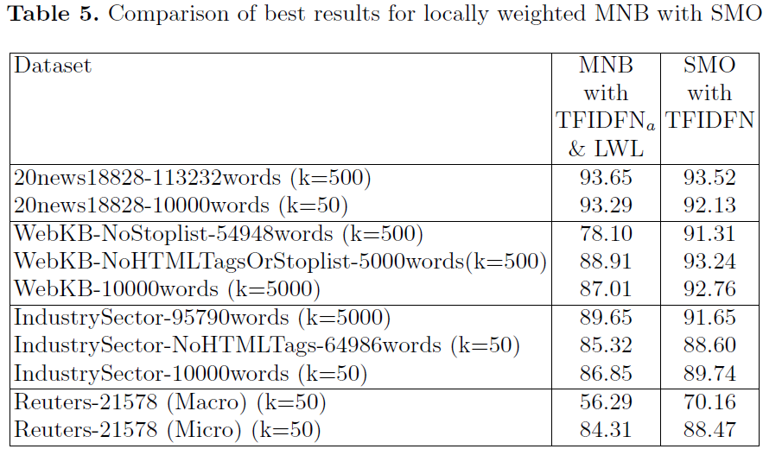

Slide 19
Conclusions
Standard MNB can be improved substantially by applying TFIDF transformation and normalizing the feature vector to the average vector length.
MNB with TFIDF outperforms TWCNB with TFIDF.
Effect of weight normalization on complement Naïve Bayes is negligible.
MNB with locally weighted learning is slightly better but not competitive with linear SVM.

Slide 20


